Slide 1
SUPERVISED MACHINE LEARNING PROJECT
PRICE PREDICTION- CLASSIFICATION PROBLEM FOR HOTEL RESERVATIONS
Giorgos Aliferis, Stelios Karouzos

Slide 2
CONTENTS
Exploratory Data Analysis
Predictions on the average Price
Classification Problem- Cancelled or not Cancelled
Improved Methods
Future suggestions

Slide 3
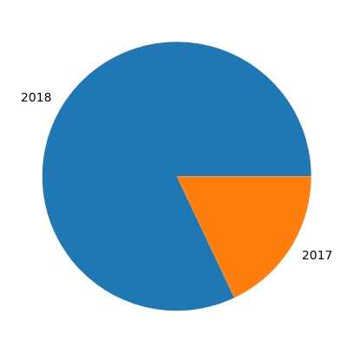
Arrival year
Year Reservations
2018 29761
2017 6514

Slide 4
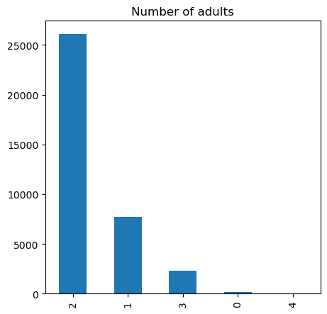
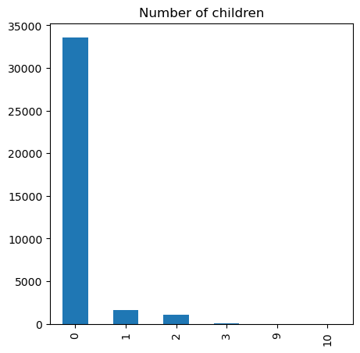
Number of Children - Number of adults

Slide 5
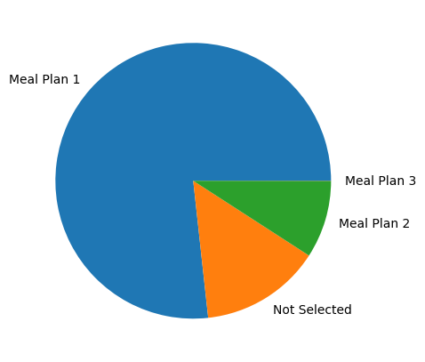
Meal of preference
Meals Total
Meal Plan 1 27835
Not Selected 5130
Meal Plan 2 3305
Meal Plan 3 5

Slide 6
Regression Problem
We want to predict the average price of a hotel room based on the reservation and room info we have
In our dataset we have 30 columns and 36K rows
There was no missing values
There was no correlation between the features

Slide 7
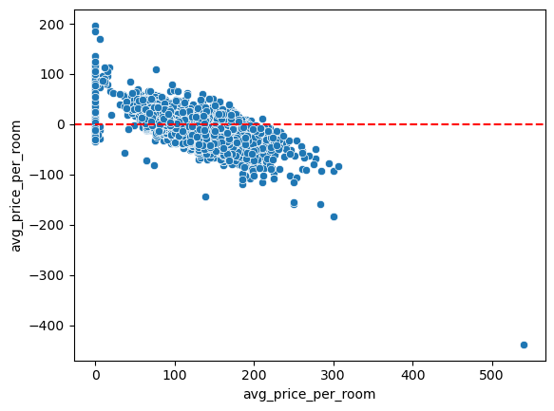
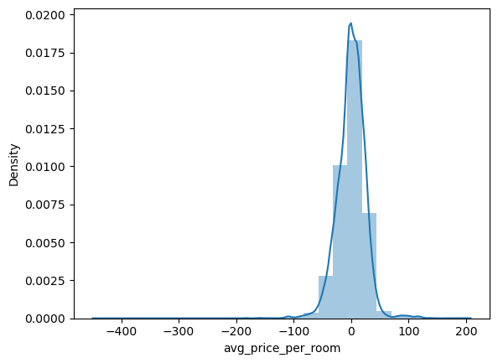
Linear Regression-results
R-squared=0.5128

Slide 8
Classification Problem-Cancelled or not
We want to predict if customers are going to cancel their reservation
It is very common that customers cancel their reservation. This has a big impact in the hotel’s revenue because they lose a lot of money.

Slide 9
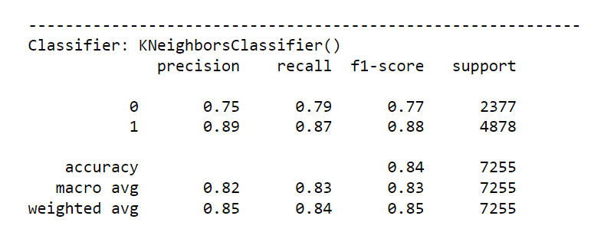
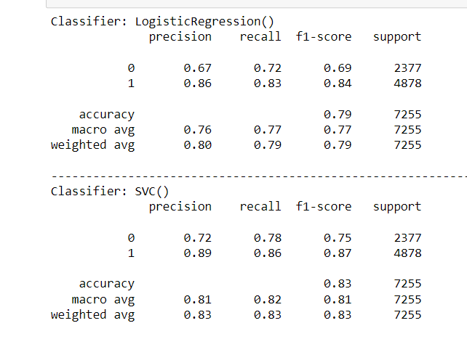
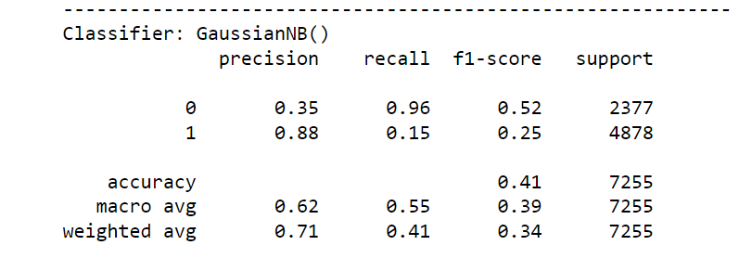
Classification Report

Slide 10
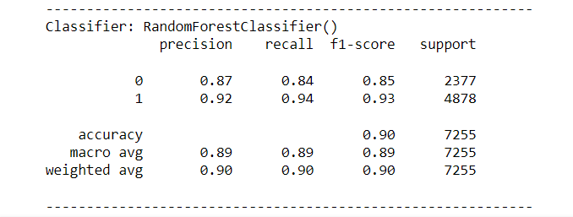
Best Classifier - Random Forest

Slide 11
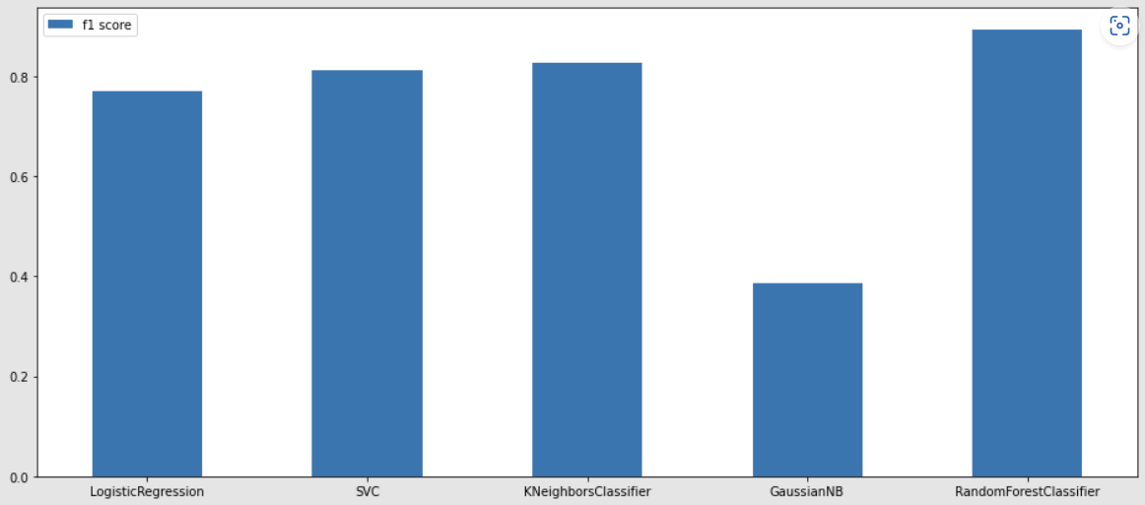
Classifier’s Performance

Slide 12
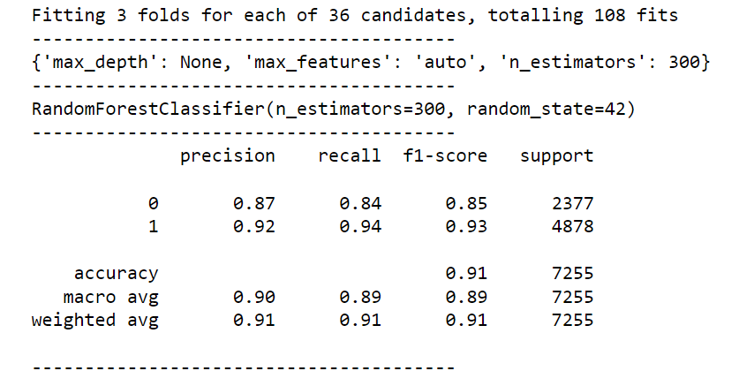
Improving the Classifier’s performance-Grid Search
We have a slightly improved algorithm.
We observe that the macro avg score on the precision and recall is higher
Conclusion: There is no need to make our algorithm more complex because there is no much different in our results

Slide 13
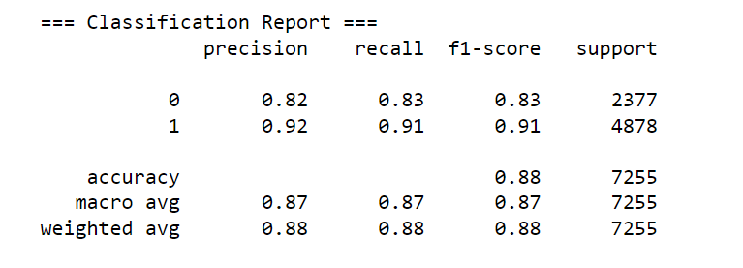
MR-MR
We observe that we have a slightly worse f1-score
We only keep the 15 most important futures for our model
Conclusion: The decrease of our features to 15 is more insignificant than the drop on our f-1 macro score. So, we decide to move on with the mr-mr Random Forest.

Slide 14
What is more to be done
Find features that are important to our average hotel room price prediction
Deployment of this model with new data to identify if a customer will cancel or not the reservation

